Slide 1
Computational Thinking?
Session-1
Notes:
Computational thinking allows us to take a complex problem, understand what the problem is and develop possible solutions. We can then present these solutions in a way that a computer, a human, or both, can understand.
There are four key techniques (cornerstones) to computational thinking:
decomposition - breaking down a complex problem or system into smaller, more manageable parts
pattern recognition – looking for similarities among and within problems
abstraction – focusing on the important information only, ignoring irrelevant detail
algorithms - developing a step-by-step solution to the problem, or the rules to follow to solve the problem

Slide 2



Were you able to finish pre-class work for Computational Thinking?
Yes
No
Notes:
🍐 This is a Pear Deck Multiple Choice Slide. Your current options are: A: 👍, B: 👎,
🍐 To edit the type of question or choices, go back to the "Ask Students a Question" in the Pear Deck sidebar.
True or False
Use this template to do a quick check of students’ perceptions during your lesson.
Hard or Easy
Use this template to do a quick temperature check and self-reflection about the homework. You can learn which students might have struggled with the assignment and therefore might need more attention today.

Slide 3
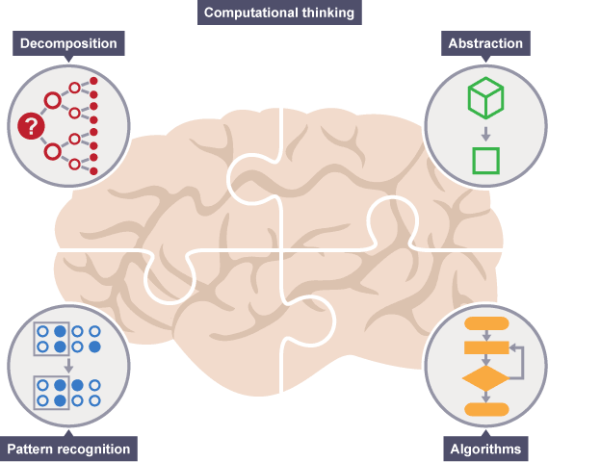
Today’s Topics
What is Computational Thinking?
Decomposition
Pattern Recognition
Abstraction
Algorithms
Notes:
Computational thinking involves taking that complex problem and breaking it down into a series of small, more manageable problems (decomposition). Each of these smaller problems can then be looked at individually, considering how similar problems have been solved previously (pattern recognition) and focusing only on the important details, while ignoring irrelevant information (abstraction). Next, simple steps or rules to solve each of the smaller problems can be designed (algorithms).

Slide 4

What is Computational Thinking?
Let’s try to predict and discuss!
Notes:
🍐 This is a Pear Deck Text Slide
🍐 To edit the type of question, go back to the "Ask Students a Question" in the Pear Deck sidebar.
Opinions of students on computational thinking should be discussed with the students. They should try to predict what it might be. If they heard it before or new it before they should try to explain it to the rest of the class. Instructor should also help them discuss by sharing opinions and guiding the class.

Slide 5
What is Computational Thinking?
Computational thinking is:
Logical thinking
Critical thinking
Problem solving
Notes:
Teacher will be explaining these parts in detail by giving example on them. And also should ask the students the way they use these stuff.
For example: Do you organise data?
Daily life examples.
Soccer match classification
Breaking problems into parts:
Cooking a dish
Cleaning your home
Orchestra (Everybody plays different instrument/ synchronization a great product)
What are patterns and models? Where do you encounter them? After asking one or two questions about the sub headers and getting answers to them, these should be explained briefly.

Slide 6

If a problem is too hard, what should you try to do?
Notes:
Summarize
Have students write a quick, 1-2 sentence summary of the information they’ve just learned.
🍐 This is a Pear Deck Text Slide
🍐 To edit the type of question, go back to the "Ask Students a Question" in the Pear Deck sidebar.

Slide 7
Some Questions to Think About Before Starting
If you find similarities in lots of solutions to different problems what does that
probably tell you?
If you have a problem that is just a little different from a problem that you have a
solution for, what would you do?
Notes:
Introduced questions will be discussed with the students. If any clue about computational thinking/ problem solving is recognized in the answers and opinions of the students that should be emphasized.

Slide 8
What is Computational Thinking?
Computational thinking is:
Breaking problems into parts (Decomposition)
Interpreting patterns and models (Pattern Recognition)
Organising data/information logically (Abstraction)
Designing and implementing algorithms (Algorithms)
Notes:
Computational thinking is an approach to solving problems using concepts and ideas from computer science and expressing solutions to those problems so that they can be run on a computer.
Teacher will be explaining these parts in detail by giving example on them. And also should ask the students the way they use these stuff.
For example: Do you organise data?
Daily life examples.
Soccer match classification
Breaking problems into parts:
Cooking a dish
Cleaning your home
Orchestra (Everybody plays different instrument/ synchronization a great product)
What are patterns and models? Where do you encounter them? After asking one or two questions about the sub headers and getting answers to them, these should be explained briefly.

Slide 9
What is programming?
Notes:
Summarize
Have students write a quick, 1-2 sentence summary of the information they’ve just learned.
🍐 This is a Pear Deck Text Slide
🍐 To edit the type of question, go back to the "Ask Students a Question" in the Pear Deck sidebar.

Slide 10
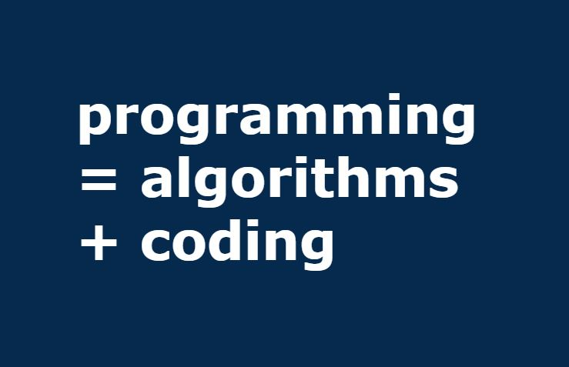
What is Computational Thinking?
Computational Thinking is the must step between having a problem and having a solution to that problem.
Computational Thinking aims to teach how to form a solution such that can be programmed into a computer.
Notes:
In this part computational thinking as a whole should be explained briefly to the students. Topic of how to explain/ program a solution into a computer can be discussed with the students.

Slide 11

Architects or Bricklayers?
Programming is like bricklaying. You don’t have to have an in depth knowledge and thinking to be able to build a wall.
Programming with computational thinking is the architecture.
Notes:
After the discussion in the previous slide, ideas shared should be connected to programming. The fact that programming is not much of a thing without computational should be emphasized. Also students should be reminded that developing software, or writing any kind of piece of code that is expected to be usefull, at its heart, is a matter of problem solving.
Programming is much like bricklaying: you need to know a little bit about it to be able to build something, and master artisans can have long and detailed conversations about pointing and the relative advantages of variations on herringbone layouts, but fundamentally a wall is a wall.
Bricklaying isn't that interesting: architecture is interesting. Just as architecture is about understanding people's requirements and seeing how a particularly shaped pile of bricks could address them, computational thinking is about understanding a problem and seeing how a particularly shaped pile of program statements could address it.

Slide 12
Four pillars of Computational Thinking
Decomposition
Pattern Recognition
Abstraction
Algorithm Design

Slide 13
Decomposition
1

Slide 14
Decomposition
Let’s discuss and try to predict what does decomposition mean in computational thinking!
Notes:
🍐 This is a Pear Deck Text Slide
🍐 To edit the type of question, go back to the "Ask Students a Question" in the Pear Deck sidebar.
In the discussion parts students are expected to contribute with their ideas and predictions about the introduced topic.

Slide 15
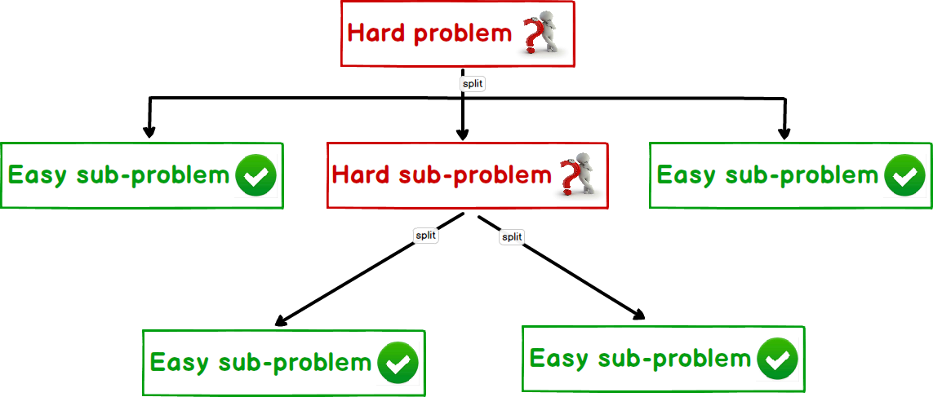
Decomposition
It basically means breaking a problem into smaller pieces.
Let’s think of some examples of decomposition!
Notes:
Breaking down data, processes, or problems into smaller, manageable parts
Decomposition is used for more than just project planning. It’s handy in understanding complex concepts, ones that are too big or cumbersome to pin down. When a concept is decomposed, the study of its constituent parts can offer novel ways to approach the subject. You can optimize processes, streamline designs or even come up with totally new ideas.
If a problem is not decomposed, it is much harder to solve. Dealing with many different stages all at once is much more difficult than breaking a problem down into a number of smaller problems and solving each one, one at a time. Breaking the problem down into smaller parts means that each smaller problem can be examined in more detail.
After the teacher briefly explains what decomposition students will try to give examples on applications of decomposition. Teacher can help them by starting with the first example or by asking questions like ‘What kind of tasks do you do on a daily basis’’ and after getting the answer teacher can ask the student if they can decompose that particular problem into smaller ones.

Slide 16
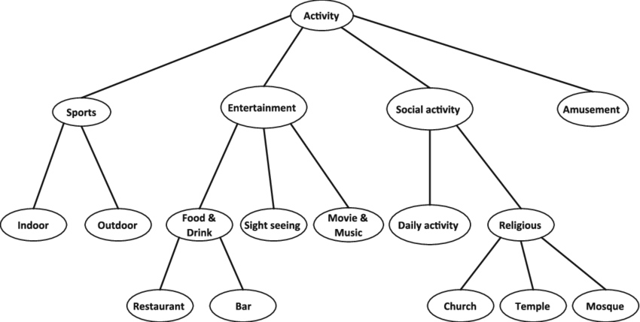
Decomposition
We use tree structures to visualize decomposition
Tree structures help us decompose problems into sub-problems.
It consists of blocks connected by branches.
Each block that is connected to its parent block which is above it, represents a sub problem of that block.
Notes:
The structure of the problem can be represented by the relationships between functions and subfunctions in a functional tree, which consists of blocks connected by branches (as shown below). A sub-function is at a level lower than its parent function.
Teacher will explain what a tree structre is and can give an example of theirselves if they want.

Slide 17
Decomposition
Try to break these problems into as much sub problems as possible and represent them with tree structures:
Making a chocolate cake
Parking a car
Preparing to go to work in the morning
Preparing vocation plan
Become IT guy
Notes:
This is a group activity. Teacher will ask students to form groups. Each group will try to decompose given problems and show them to the teacher. After every one is finished groups can compare each others tree structures and see how much more or less they could have divided the problems into sub-problems.
*** 3 example decomposition
3 different slides

Slide 18
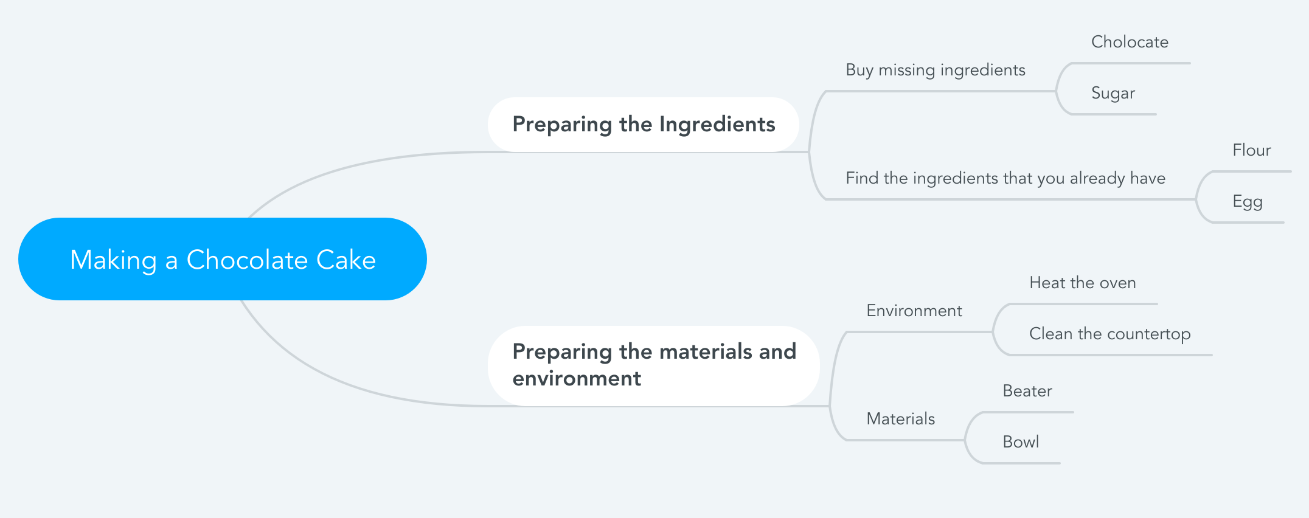
Making A Chocolate Cake

Slide 19
Parking a Car
Finding a spot that fits the car
Parking
Take a tour at the parking lot
Stop when you find an empty spot
Set the gear to R or D
Turn on the parking lights
Drive into the spot carefully

Slide 20
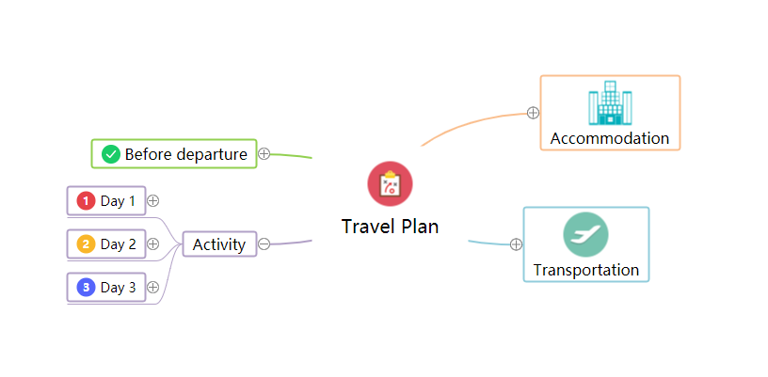
Preparing Vacation Plan
Notes:
🍐 This is a Pear Deck Web Slide.
🍐 To edit the type of question, go back to the "Ask Students a Question" in the Pear Deck sidebar.
Mind Map
Starting with a central idea, give students time to branch out their thoughts visually to help build connections.

Slide 21
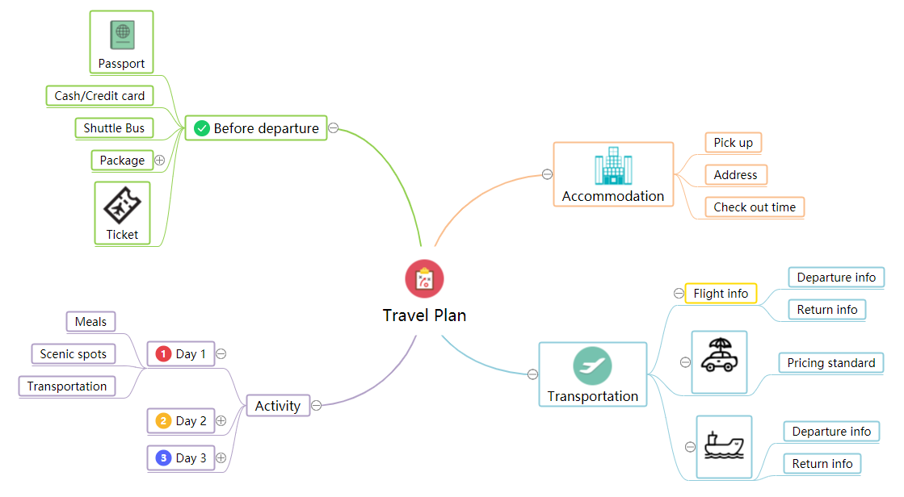
Preparing Vacation Plan

Slide 22
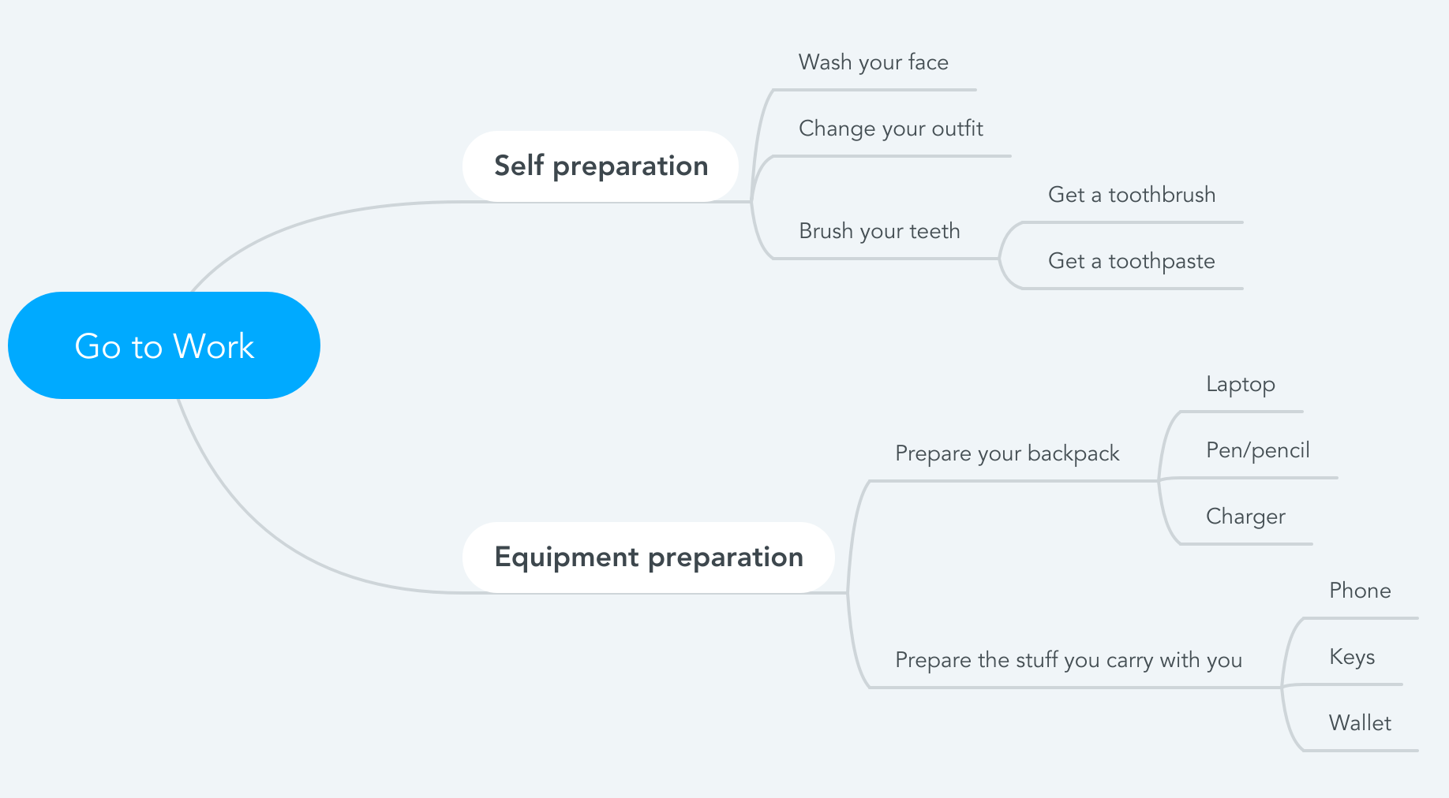
Preparing to Go to Work in the Morning
Notes:
Mind Map
Starting with a central idea, give students time to branch out their thoughts visually to help build connections.
🍐 This is a Pear Deck Drawing Slide
🍐 To edit the type of question, go back to the "Ask Students a Question" in the Pear Deck sidebar.

Slide 23
Preparing to Go to Work in the Morning
Notes:
https://www.mindmeister.com/?r=470018

Slide 24
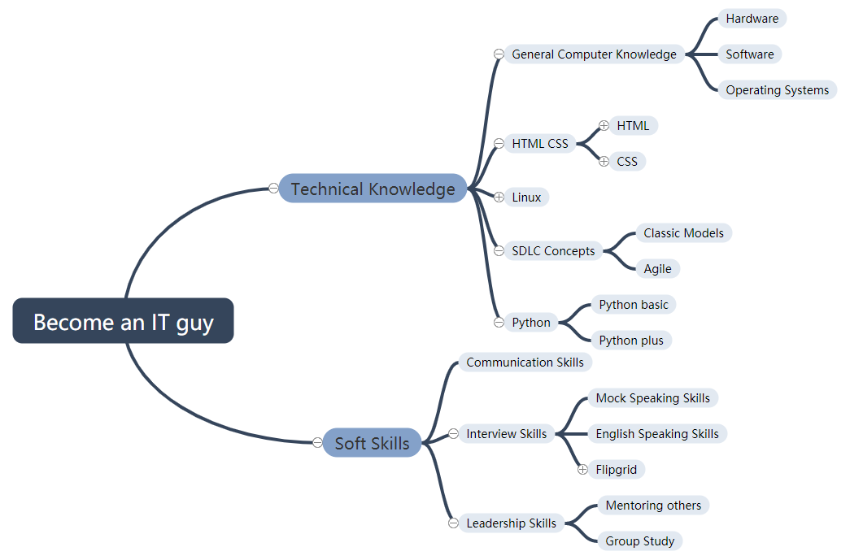
Let’s decompose what you’re doing right now?
Notes:
🍐 This is a Pear Deck Web Slide.
🍐 To edit the type of question, go back to the "Ask Students a Question" in the Pear Deck sidebar.
Mind Map
Starting with a central idea, give students time to branch out their thoughts visually to help build connections.

Slide 25
Challenge

Slide 26
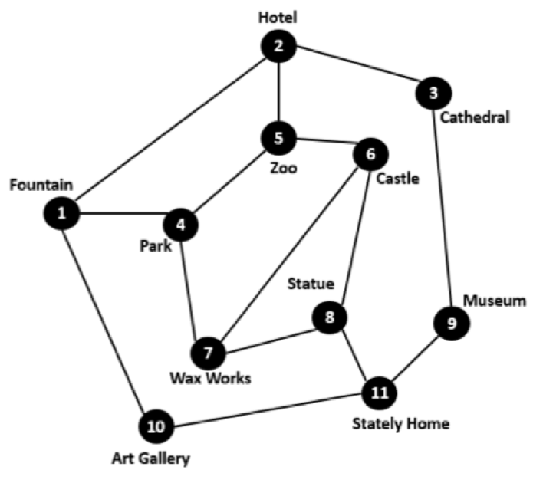
Decomposition Challenge
You are a tour guide. Tourists have booked a tour visiting all the city’s attractions starting from the hotel they are staying in. This map shows where the attractions are and roads that connect them. You must work out a route that takes your tour group to every tourist site. The tourists will not be happy if they pass through the same place twice. They also want to end up back at their hotel that evening.
Notes:
🍐 This is a Pear Deck Text Slide
🍐 To edit the type of question, go back to the "Ask Students a Question" in the Pear Deck sidebar.
In this part to understand how simple computers are compared to humans, students will take part in an activity called ‘’Battleships’’ where there will be introduced to a simple sorting algorithm. Instructions to the game are in the following link.
https://classic.csunplugged.org/wp-content/uploads/2014/12/unplugged-06-searching_algorithms.pdf
After completing this activity. The simplicity of a computer should be emphasized in terms of the way computers ‘’understand’’ human stuff.

Slide 27
Decomposition Challenge
You are a tour guide. Tourists have booked a tour visiting all the city’s attractions starting from the hotel they are staying in. This map shows where the attractions are and roads that connect them. You must work out a route that takes your tour group to every tourist site. The tourists will not be happy if they pass through the same place twice. They also want to end up back at their hotel that evening.
2, 3, 9, 11, 10, 1, 4, 7, 8, 6, 5, 2
Notes:
🍐 This is a Pear Deck Text Slide
🍐 To edit the type of question, go back to the "Ask Students a Question" in the Pear Deck sidebar.
In this part to understand how simple computers are compared to humans, students will take part in an activity called ‘’Battleships’’ where there will be introduced to a simple sorting algorithm. Instructions to the game are in the following link.
https://classic.csunplugged.org/wp-content/uploads/2014/12/unplugged-06-searching_algorithms.pdf
After completing this activity. The simplicity of a computer should be emphasized in terms of the way computers ‘’understand’’ human stuff.

Slide 28
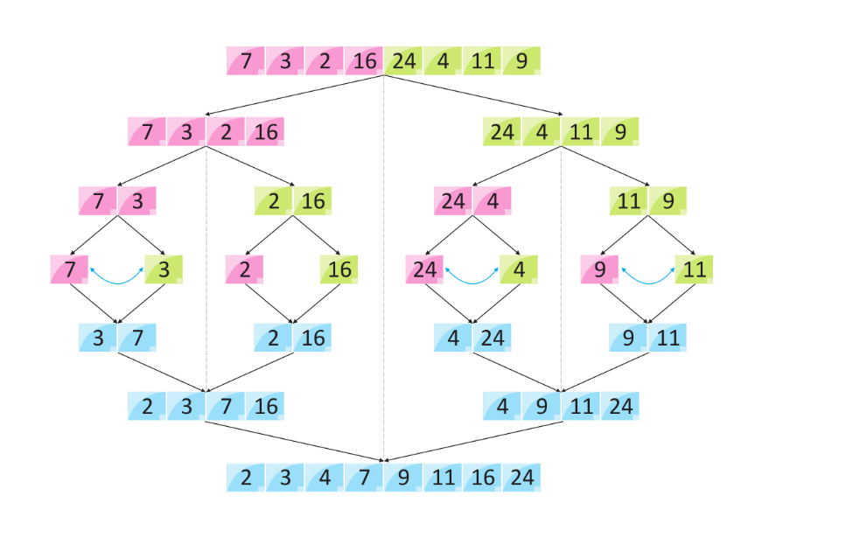
Decomposition Exampel

Slide 29

Recap Time
Do you use decomposition in solving your daily problems? if so, what are some examples?
Have you ever used tree structures before? Where did you use them?
Notes:
Recap time

Slide 30
Pattern Recognition
2

Slide 31
Pattern Recognition
Let’s discuss and try to predict what does pattern recognition mean in computational thinking!
Notes:
🍐 This is a Pear Deck Text Slide
🍐 To edit the type of question, go back to the "Ask Students a Question" in the Pear Deck sidebar.

Slide 32
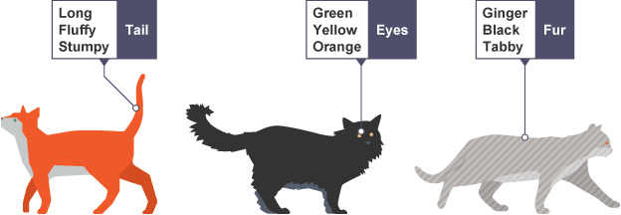
Pattern Recognition
Pattern recognition is recognising patterns in different things (solutions) and being able to apply these patterns in the solutions of other similar problems.
Pattern recognition is good because we don’t have to come up with a new solution each time we encounter the same problem. Instead, we apply the patterns that we have previously recognized.

Slide 33
Challenge
add all the numbers from 1 to 200
Big problem?
Did you try?
A lot to do in your head?
Notes:
In this part to understand how simple computers are compared to humans, students will take part in an activity called ‘’Battleships’’ where there will be introduced to a simple sorting algorithm. Instructions to the game are in the following link.
https://classic.csunplugged.org/wp-content/uploads/2014/12/unplugged-06-searching_algorithms.pdf
After completing this activity. The simplicity of a computer should be emphasized in terms of the way computers ‘’understand’’ human stuff.

Slide 34
Pattern Recognition Exercises
Look at the following number patterns and find the sequence.
1 2 5 10 17 ?
Notes:
🍐 This is a Pear Deck Multiple Choice Slide. Your current options are: A: 21, B: 26, C: 27, D: 30,
🍐 To edit the type of question or choices, go back to the "Ask Students a Question" in the Pear Deck sidebar.

Slide 35
Pattern Recognition Exercises
Look at the following number patterns and find the sequence.
1 2 5 10 17 26
Add 1, 3, 5, 7, 9 etc. to previous number

Slide 36
Pattern Recognition Exercises
Look at the following number patterns and find the sequence.
123 117 108 99 ?
Notes:
🍐 This is a Pear Deck Multiple Choice Slide. Your current options are: A: 81, B: 88, C: 90, D: 93,
🍐 To edit the type of question or choices, go back to the "Ask Students a Question" in the Pear Deck sidebar.

Slide 37
Pattern Recognition Exercises
Look at the following number patterns and find the sequence.
123 117 108 99 81
Subtract the sum of previous digits (1 + 2 + 3 = and 123-6 = 117)
Notes:
🍐 This is a Pear Deck Text Slide
🍐 To edit the type of question, go back to the "Ask Students a Question" in the Pear Deck sidebar.

Slide 38
Pattern Recognition Exercises
Look at the following number patterns and find the sequence.
12 48 163 26 412 ????
Notes:
🍐 This is a Pear Deck Text Slide
🍐 To edit the type of question, go back to the "Ask Students a Question" in the Pear Deck sidebar.

Slide 39
Pattern Recognition Exercises
Look at the following number patterns and find the sequence.
12 48 163 26 412 8
The spaces are incorrectly added, when they are correct it is a simple x 2 pattern
Notes:
🍐 This is a Pear Deck Text Slide
🍐 To edit the type of question, go back to the "Ask Students a Question" in the Pear Deck sidebar.

Slide 40
Pattern Recognition Exercises
Look at the following number patterns and find the sequence.
849 352 768 493 527 ?
Notes:
🍐 This is a Pear Deck Text Slide
🍐 To edit the type of question, go back to the "Ask Students a Question" in the Pear Deck sidebar.

Slide 41
Pattern Recognition Exercises
Look at the following number patterns and find the sequence.
849 352 768 493 527 684
The numbers are 84935276 repeated and then split into groups of 3 digits
Notes:
🍐 This is a Pear Deck Text Slide
🍐 To edit the type of question, go back to the "Ask Students a Question" in the Pear Deck sidebar.

Slide 42
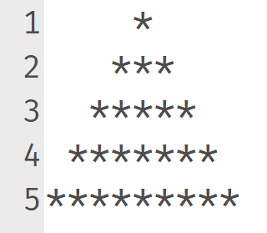
Pattern Recognition Exercises
Look at the following number patterns and find the sequence.
Notes:
🍐 This is a Pear Deck Text Slide
🍐 To edit the type of question, go back to the "Ask Students a Question" in the Pear Deck sidebar.

Slide 43
Finding The Rules of the Game
Can you find the rules for this game? If so, how did you find the rules?
Notes:
🍐 This is a Pear Deck Text Slide
🍐 To edit the type of question, go back to the "Ask Students a Question" in the Pear Deck sidebar.

Slide 44
Finding the Rules of the Game
To find the rules we found a pattern that is repeated in both of the user experiences:
Phrases like “I guess a number in between 0 and 10”, “someone tried to guess it and sayed…” and “I said …” are repeated. So we can use these phrases to be able to play the game. Except, we change the parts like the numbers that we guess and statements about the number that is guessed saying whether it is above or below the number that the player thought of.

Slide 45
Recap Time
What are some patterns that you recognise in your daily life/problems?
So far, we have learned decomposition and pattern recognition. Can you give an example of combining those to in a solution of a problem?

Slide 46
Abstraction
3

Slide 47
Abstraction
Let’s discuss and try to predict what does abstraction mean in computational thinking!
Notes:
🍐 This is a Pear Deck Text Slide
🍐 To edit the type of question, go back to the "Ask Students a Question" in the Pear Deck sidebar.

Slide 48
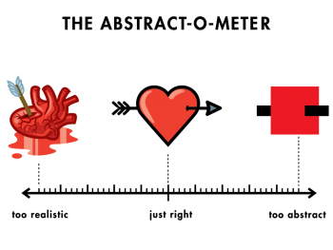
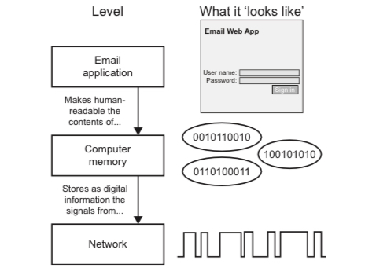
Abstraction
Abstraction is getting rid of the useless information that is not going to have any contribution to the solution.
Abstraction is the core concept of computer science and computational thinking. To be able to express a real world problem to a computer, the problem has to be abstract.

Slide 49
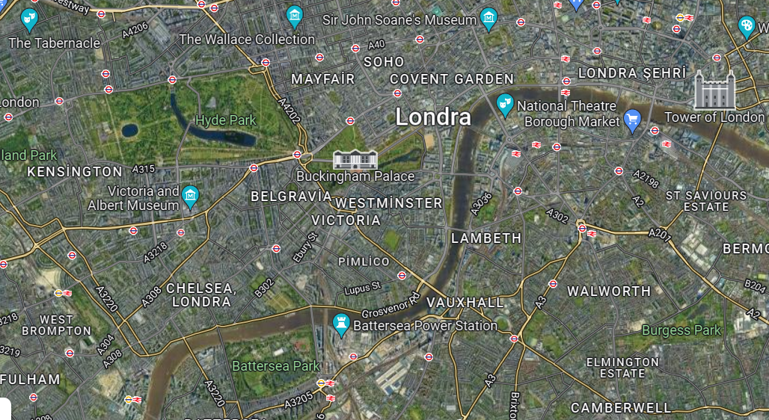
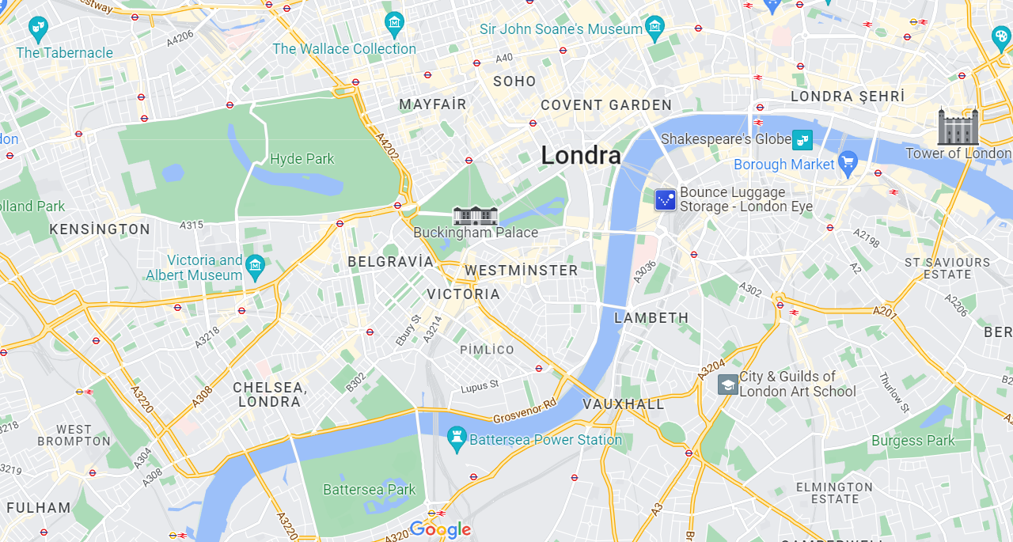
Abstraction

Slide 50
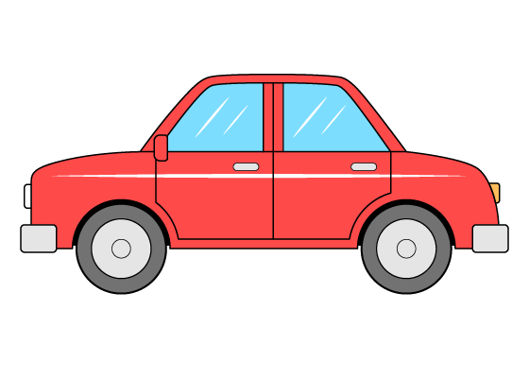



Let’s abstract stuff!
The key part of abstraction is ignoring the useless aspects of something and including the beneficial aspects. So, find out the useless aspects that are going to be ignored and the beneficial aspects that are going to be considered of the items below. Try going abstract as far as possible. (For example a house is nothing but a shelter for humans when you look abstractly)
Car
Pencil
House
Mobile phone
HINT: Think of what do these objects help solving and which aspects of them wouldn’t prevent them from solving that particular problem.
Notes:
🍐 This is a Pear Deck Text Slide
🍐 To edit the type of question, go back to the "Ask Students a Question" in the Pear Deck sidebar.

Slide 51
Let’s Abstract Stuff!
The abstractions should look something like this:
Object | Include | Ignore
Car | Engine, tires, rims, seat | Color, shape, trunk, radio
Pencil | color of the tip, grip | material, brand, type
Mobile phone | speaker, microphone,cellular | color, brand, camera

Slide 52
Let’s Abstract Stuff!
Finally, try to describe the objects that you have abstracted, ignoring the parts that you think should be ignored, and including the parts that you think should be included.

Slide 53
Recap Time
What are some examples of abstraction that we encounter in our daily lives?
Do you think that you already abstract stuff? Can you give any examples?
Why do you think abstraction is important for computer science?

Slide 54
Algorithm
4

Slide 55
Algorithm
Let’s discuss and try to predict what does algorithm design mean in computational thinking!

Slide 56
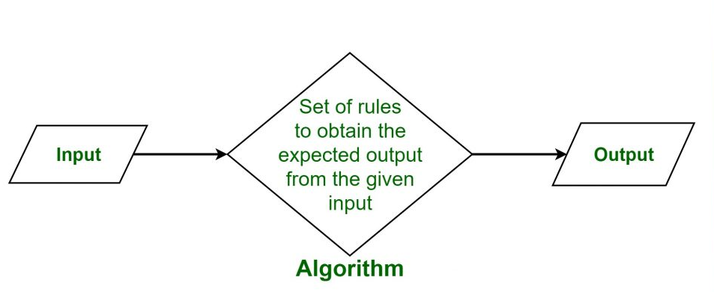
What is Algorithm

Slide 57
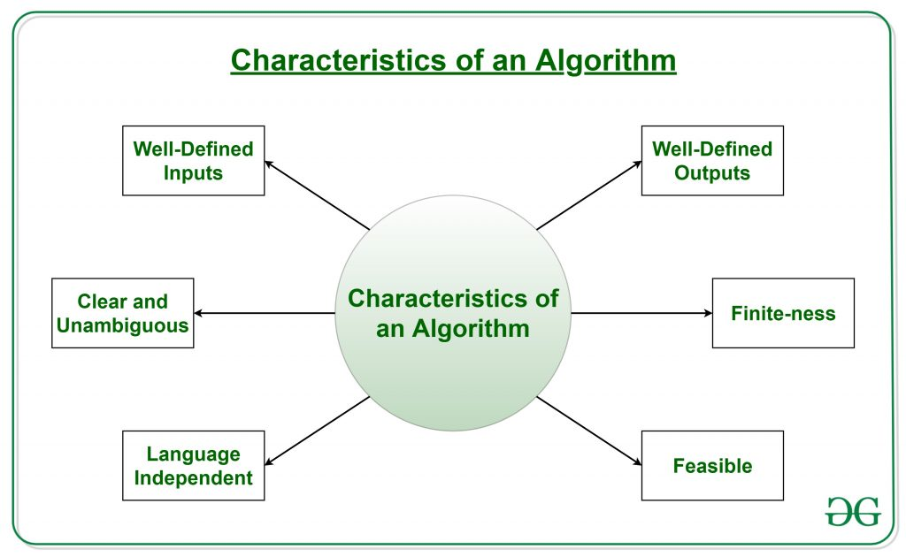
What is Algorithm

Slide 58
Brief Explanation of Algorithm
An algorithm is a sequence of clearly defined steps to describe a process.
Algorithms are useful when we wish to explain someone else or a computer how to carry out steps.
Algorithms are important for programming because a correct algorithm is the ultimate basis of any computer-based solution.

Slide 59
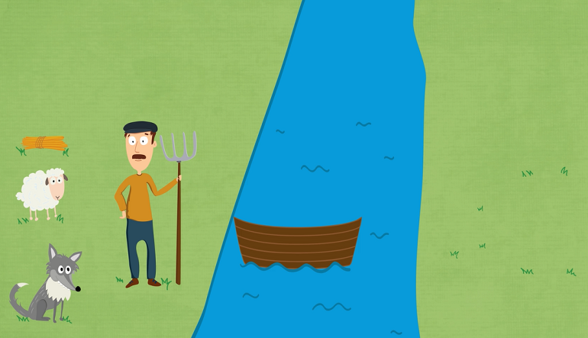
What is Computational Thinking?

Slide 60
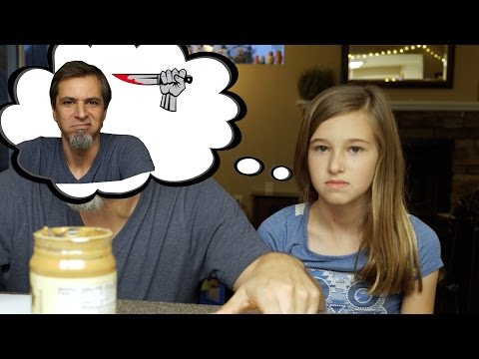
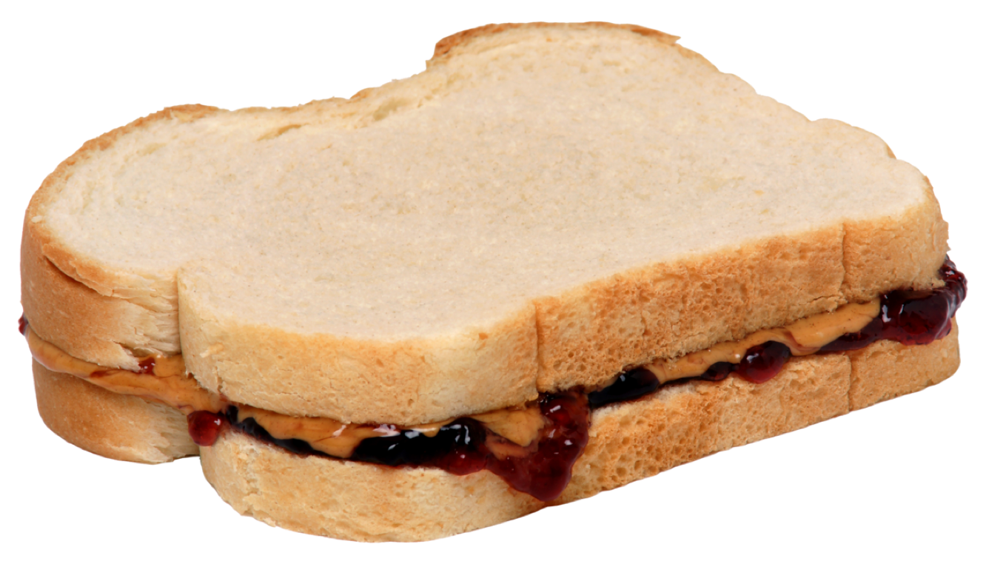
Exact Instructions
Notes:
https://www.youtube.com/watch?time_continue=1&v=cDA3_5982h8&feature=emb_logo

Slide 61
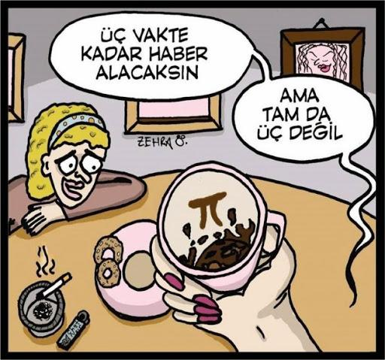
Let’s brew a coffee
?
Notes:
🍐 This is a Pear Deck Text Slide
🍐 To edit the type of question, go back to the "Ask Students a Question" in the Pear Deck sidebar.

Slide 62

Let’s brew coffee
Prepare ingredients
Make coffee
Prepare serving
Enjoy
Notes:
🍐 This is a Pear Deck Text Slide
🍐 To edit the type of question, go back to the "Ask Students a Question" in the Pear Deck sidebar.

Slide 63
Let’s brew a coffee
START
Fetch a tea cup
Boil some water
Place a tea bag into the cup
Pour on boiling water
Stir tea bag
Remove tea bag
END

Slide 64


Slide 65

THANKS!
Any questions?

